Slide 1
Creating a Dual Subsystem Virtual Platform
Helium Training Labs
Helium 22.12

Slide 2
Introduction
In this lab we will create a virtual platform containing 2 CPU subsystems
The CPUs used will be ARM A55 and ARM M35
We will use the Helium Platform Assembly GUI to do this
We will not be building this platform from scratch; instead, we will re-use existing reference platforms from the Helium catalog, and modify them as necessary

Slide 3
The platform we will create
A55
GIC
UART
M35
UART
Router
Router
DDR
SRAM
Peripherals
SRAM
Peripherals
A55 subsystem
M35 subsystem
Dual subsystem virtual platform

Slide 4
Setting up the training materials
The training materials delivered with this Helium training require some setup before use:
Extract the training material tarball
Setup the tool paths and environment variables required

Slide 5
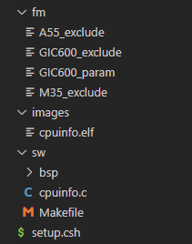
Contents of the Training Material Tarball
Files used in ARM Fast Model creation
Pre-built software images
Software source code
Script to setup the tool paths

Slide 6
Log in to hsv-sc48
These lab materials have been tested on hsv-sc48.
For best results, you should run these labs on hsv-sc48.
Run the following commands to get a shell on hsv-sc48:
> source /grid/sfi/farm/hsvlsf01/conf/cshrc.lsf
> bsub -Is -q interactive_vxehw -m hsv-sc48 csh

Slide 7
Extract the Tab Material Tarball and Setup Tool Paths
Execute the following commands in your shell:
> source ${HELIUM_INST_DIR}/helium_setup.csh
> mkdir <work directory>
> cd <work directory>
> tar -xf /path/to/training/material/tarball
> cd pa_training_material
> source setup.csh
HELIUM_INST_DIR is the directory where Helium is installed
setup.csh sets the TRAINING_MAT_DIR environment variable which is used in the labs.

Slide 8
Steps
Step 1 – Create the ARM Fast Models
Step 2 – Create a new platform
Step 3 – Instantiate the a53_gic400 platform
Step 4 – Replace the A53 with A55
Step 5 – Replace the GIC400 with GIC600
Step 6 – Clean up
Step 7 – Instantiate the basic_m7 platform
Step 8 – Replace the M7 with M35
Step 9 – Set run options
Step 10 – Save the platform to a catalog
Step 11 – Build & run the platform

Slide 9
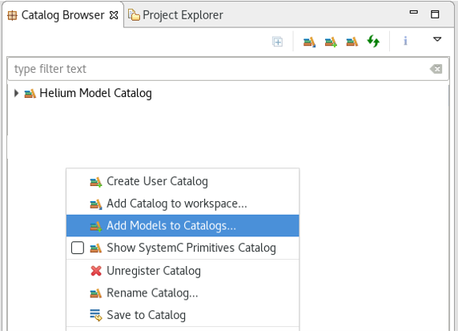
Step 1: Create the ARM Fast Models Create a catalog for the ARM models
Right click, add models to catalogs

Slide 10
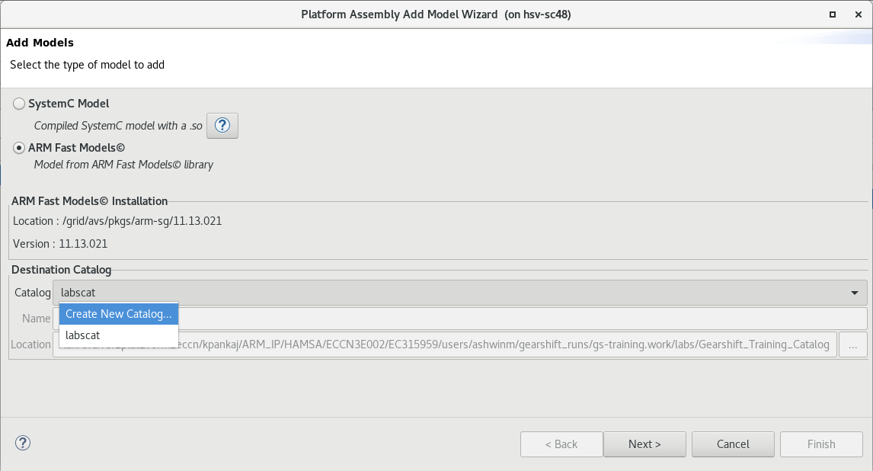
Step 1: Create the ARM Fast Models Create a catalog for the ARM models : Create a new catalog
1. Add ARM Fast Models
2. Create a new catalog

Slide 11
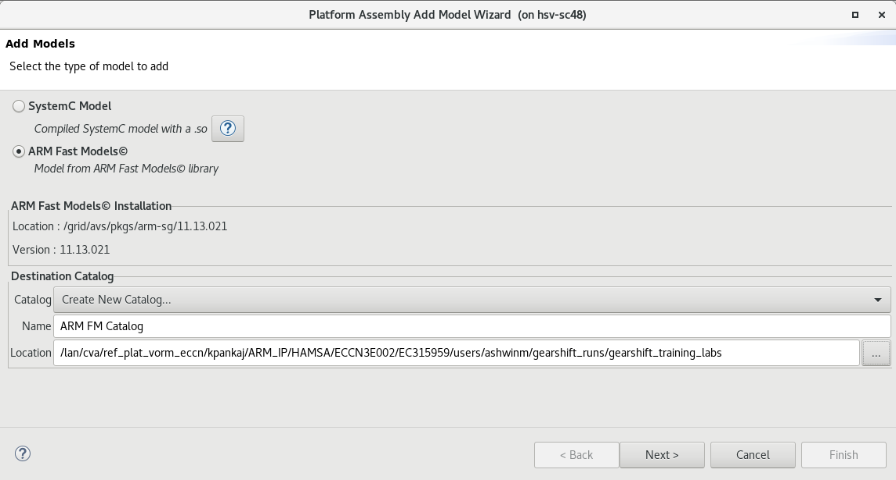
Step 1: Create the ARM Fast Models Create a catalog for the ARM models : Name the new catalog
1. Name it ARM FM Catalog
2. Browse to a suitable location
3. Next

Slide 12
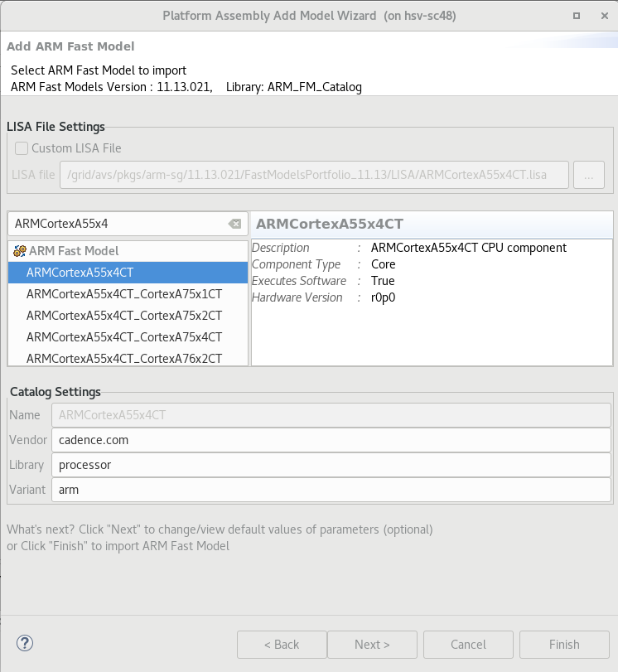
Step 1: Create the ARM Fast Models Create a catalog for the ARM models : Add ARMCortexA55x4 to the new catalog
1. Select the ARMCortexA55x4CT model
2. Next

Slide 13
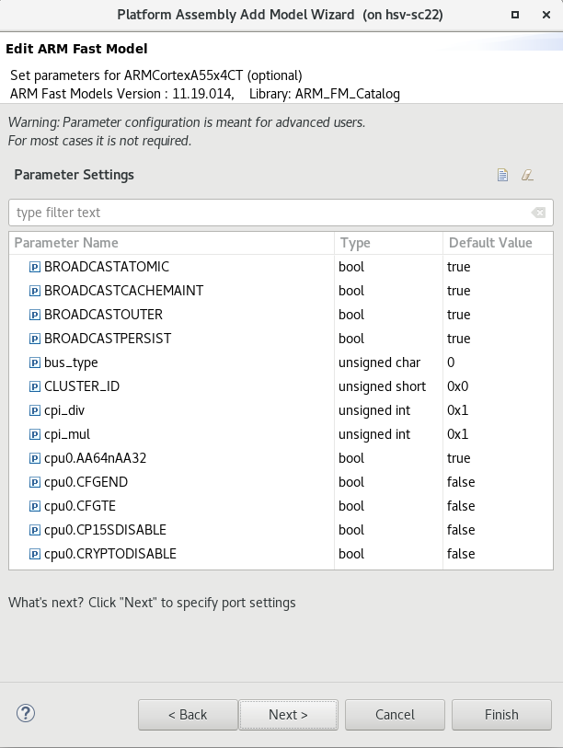
Step 1: Create the ARM Fast Models Create a catalog for the ARM models : Retain the default CPU parameter values
Next

Slide 14
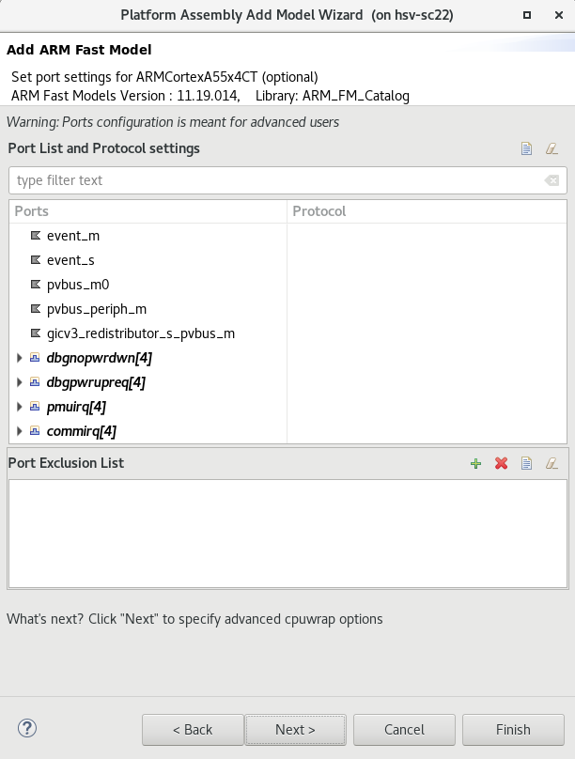
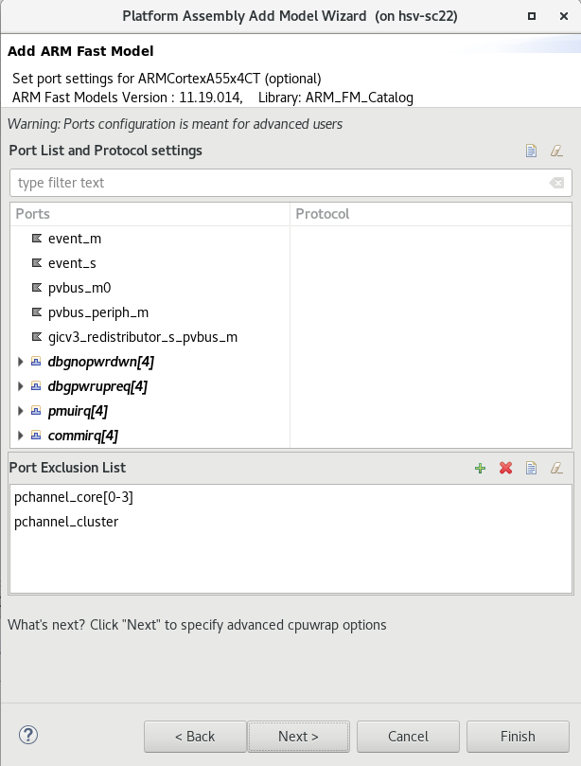
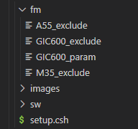
Step 1: Create the ARM Fast Models Create a catalog for the ARM models : Exclude some ports from the CPU model
1. Browse to the CPU port exclude file in the training materials
2. Next

Slide 15
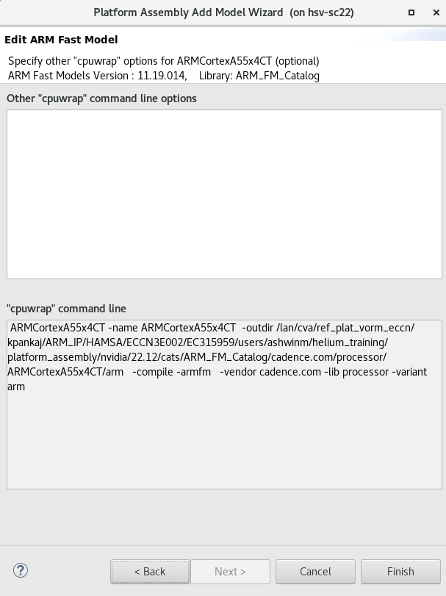
Step 1: Create the ARM Fast Models Create a catalog for the ARM models : Finish the CPU model
Finish (the model import will take a few minutes after this)

Slide 16
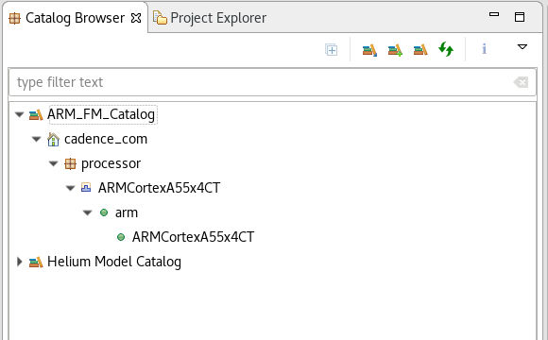
Step 1: Create the ARM Fast Models Create a catalog for the ARM models : ARMCortexA55x4 model ready
The ARMCortexA55x4 CPU model is now ready to use

Slide 17
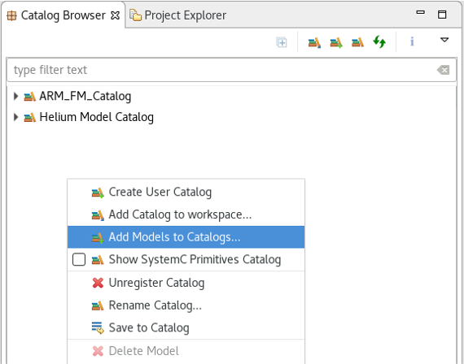
Step 1: Create the ARM Fast Models Create a catalog for the ARM models : Add the GIC600 model to the catalog
Right click, add models to catalogs

Slide 18
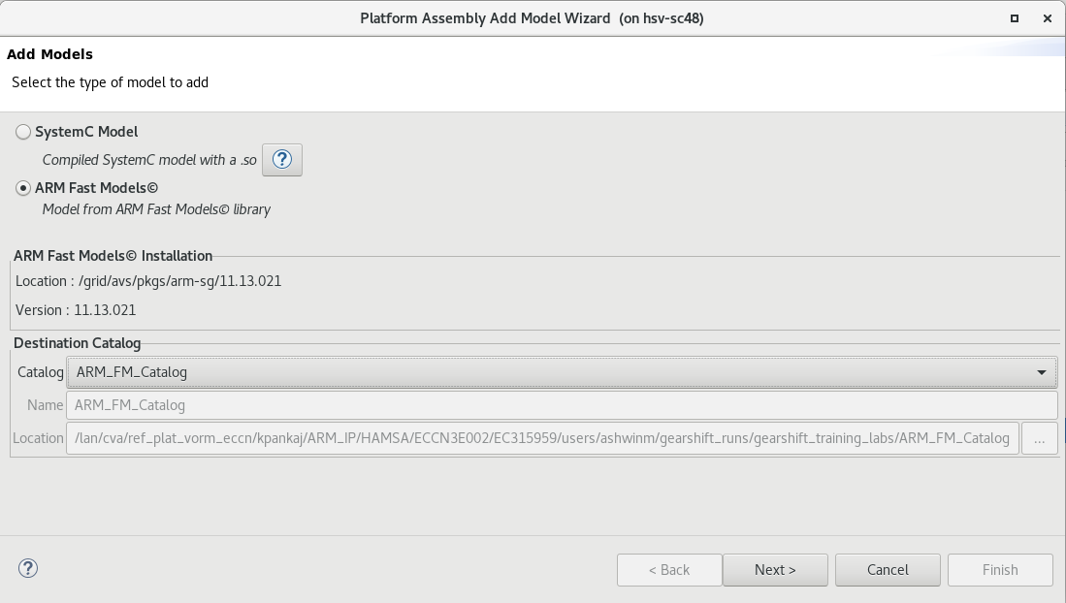
Step 1: Create the ARM Fast Models Create a catalog for the ARM models : Select the ARM FM catalog
1. Add ARM Fast Models
2. Select the ARM_FM_Catalog catalog
3. Next

Slide 19
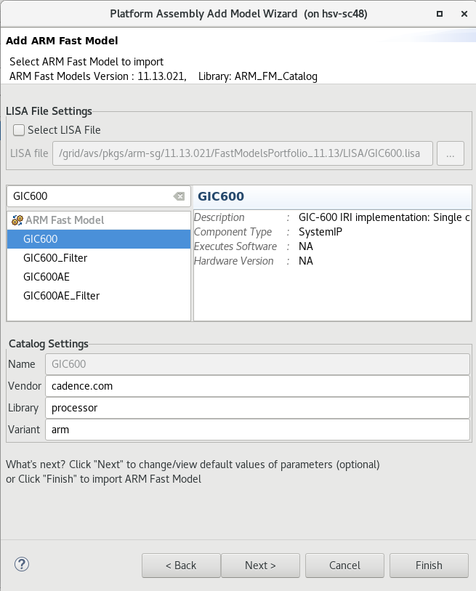
Step 1: Create the ARM Fast Models Create a catalog for the ARM models : Select the GIC600 model
1. Select the GIC600 model
2. Next

Slide 20
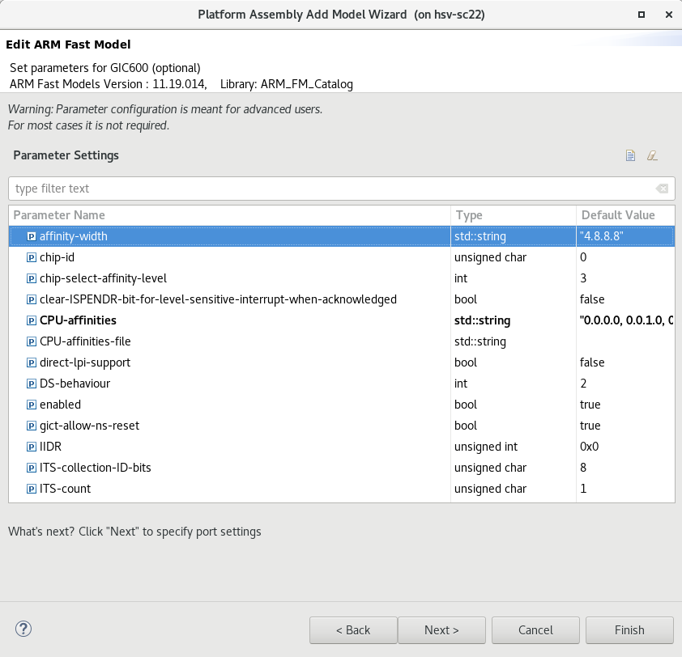
Step 1: Create the ARM Fast Models Create a catalog for the ARM models : Override some GIC parameter values
1. Browse to the GIC600 parameter file in the training materials
2. Next

Slide 21
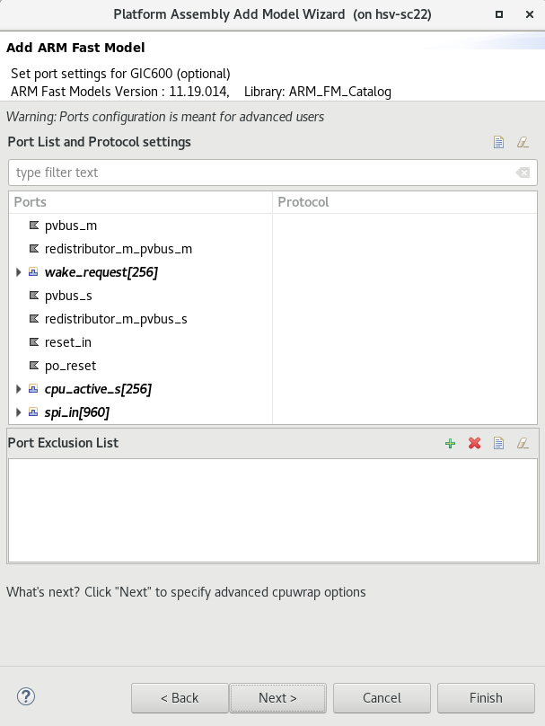
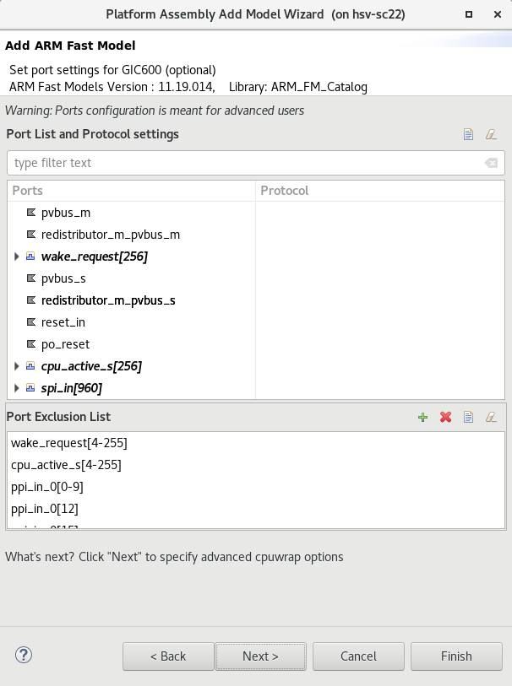
Step 1: Create the ARM Fast Models Create a catalog for the ARM models : Exclude some ports from the GIC model
1. Browse to the GIC600 port exclude file in the training materials
2. Next

Slide 22
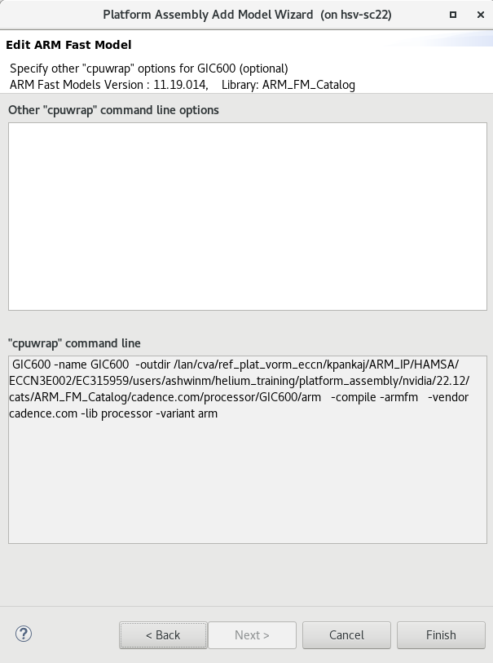
Step 1: Create the ARM Fast Models Create a catalog for the ARM models : Finish the GIC model
Finish (the model import will take a few minutes after this)

Slide 23
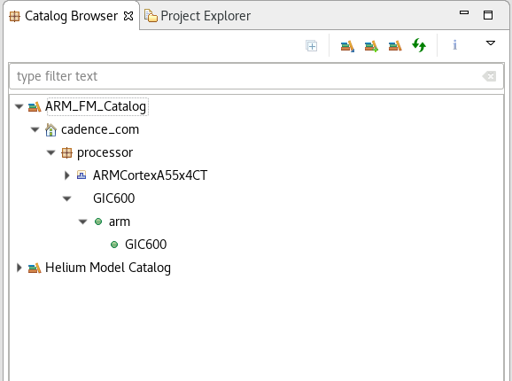
Step 1: Create the ARM Fast Models Create a catalog for the ARM models : GIC600 model ready
The GIC600 model is now ready to use

Slide 24
Step 1: Create the ARM Fast Models Create a catalog for the ARM models : Add the ARMCortexM35 model to the catalog
Right click, add models to catalogs

Slide 25
Step 1: Create the ARM Fast Models Create a catalog for the ARM models : Select the ARM FM catalog
1. Add ARM Fast Models
2. Select the ARM_FM_Catalog catalog
3. Next

Slide 26
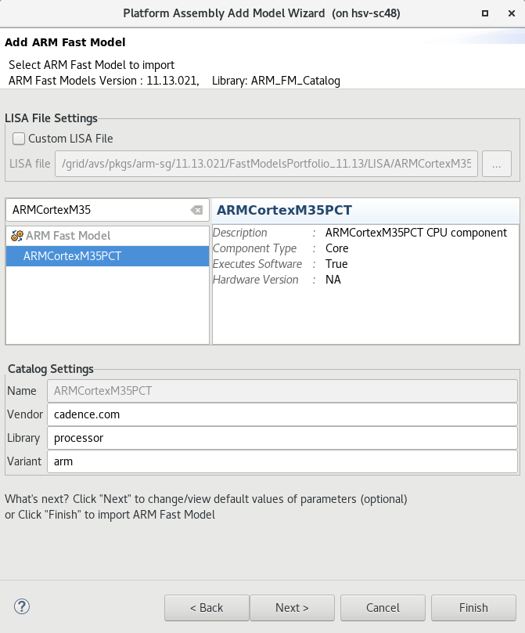
Step 1: Create the ARM Fast Models Create a catalog for the ARM models : Select the ARMCortexM35 model
1. Select the ARMCortexM35PCT model
2. Next

Slide 27
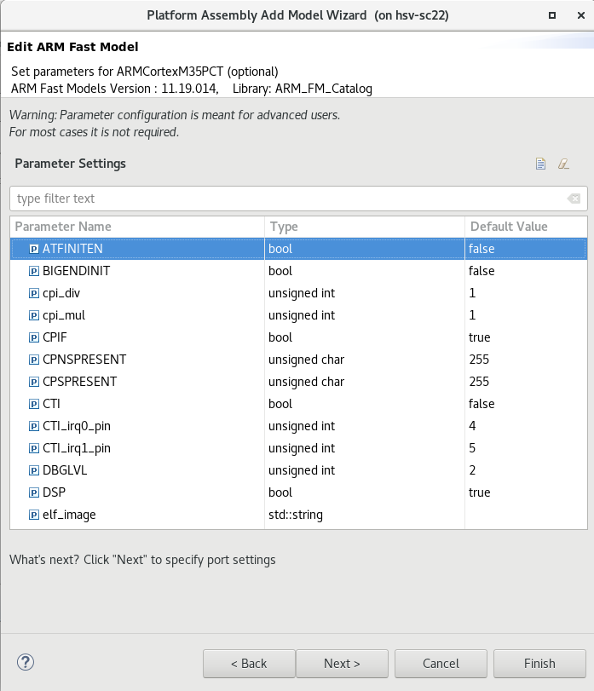
Step 1: Create the ARM Fast Models Create a catalog for the ARM models : Retain the default CPU parameter values
Next

Slide 28
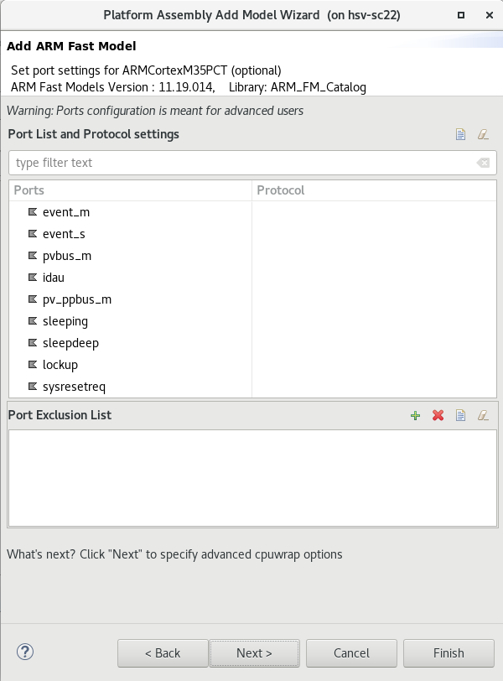
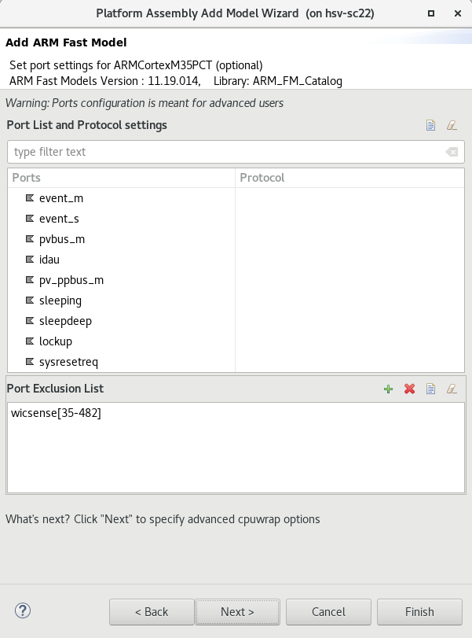
Step 1: Create the ARM Fast Models Create a catalog for the ARM models : Exclude some ports from the CPU model
1. Browse to the M35 port exclude file in the training materials
2. Next

Slide 29
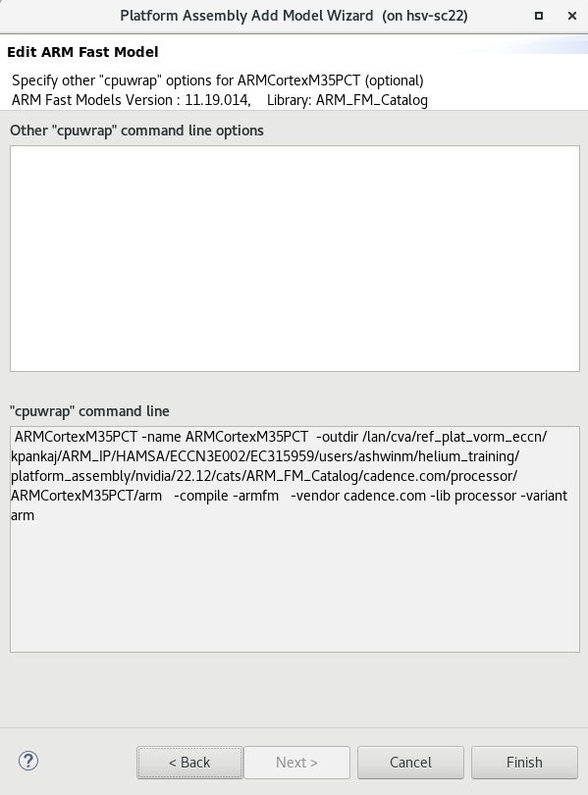
Step 1: Create the ARM Fast Models Create a catalog for the ARM models : Finish the CPU model
Finish (the model import will take a few minutes after this)

Slide 30
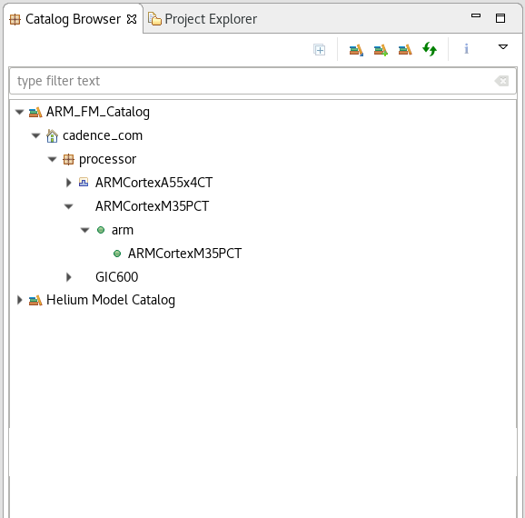
Step 1: Create the ARM Fast Models Create a catalog for the ARM models : ARMCortexM35 model ready
The ARMCortexM35PCT model is now ready to use

Slide 31
Step 1: Create the ARM Fast Models Create a catalog for the ARM models : Add the IDAU model to the catalog
Right click, add models to catalogs

Slide 32
Step 1: Create the ARM Fast Models Create a catalog for the ARM models : Select the ARM FM catalog
1. Add ARM Fast Models
2. Select the ARM_FM_Catalog catalog
3. Next

Slide 33
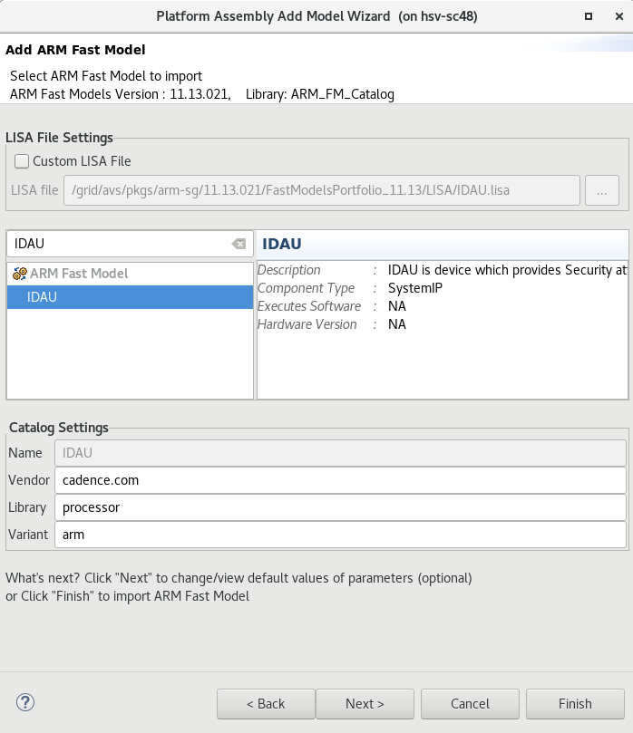
Step 1: Create the ARM Fast Models Create a catalog for the ARM models : Select the IDAU model
1. Select the IDAU model
2. Next

Slide 34
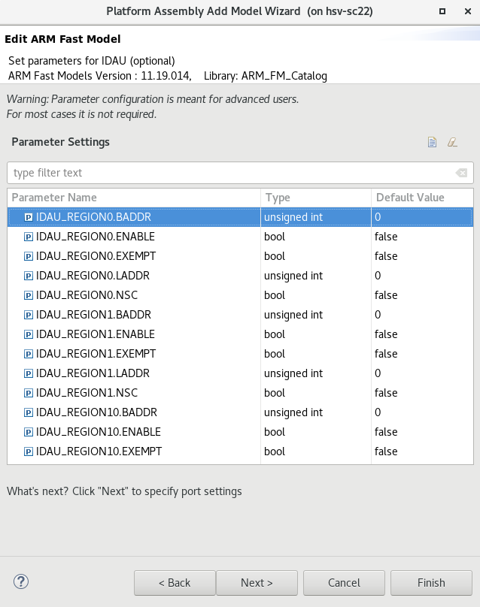
Step 1: Create the ARM Fast Models Create a catalog for the ARM models : Retain the default IDAU parameter values
Next

Slide 35
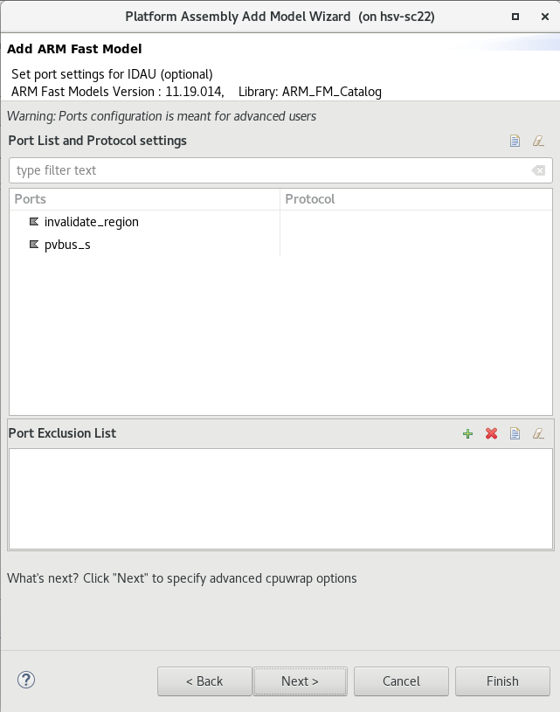
Step 1: Create the ARM Fast Models Create a catalog for the ARM models : Don’t exclude any ports
Next

Slide 36
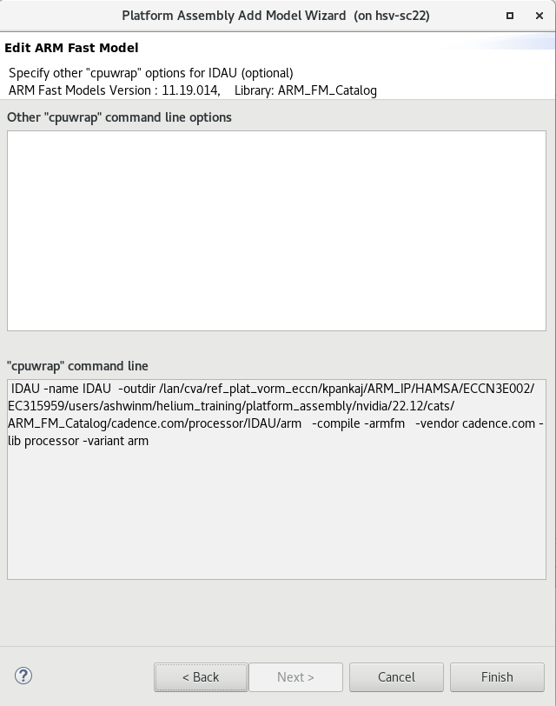
Step 1: Create the ARM Fast Models Create a catalog for the ARM models : Finish creating the IDAU model
Finish (the model import will take a few minutes after this)

Slide 37
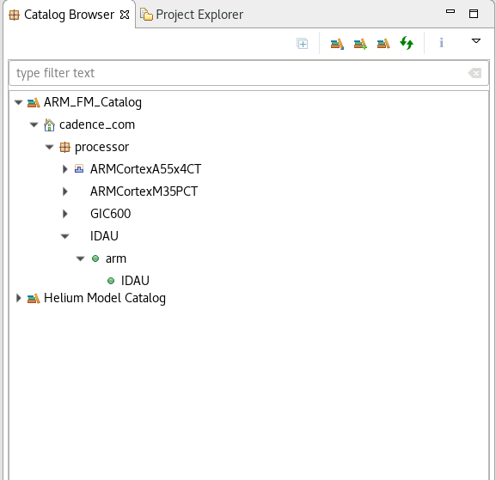
Step 1: Create the ARM Fast Models Create a catalog for the ARM models : IDAU model ready
The IDAU model is now ready to use

Slide 38
Steps
Step 1 – Create the ARM Fast Models
Step 2 – Create a new platform
Step 3 – Instantiate the a53_gic400 platform
Step 4 – Replace the A53 with A55
Step 5 – Replace the GIC400 with GIC600
Step 6 – Clean up
Step 7 – Instantiate the basic_m7 platform
Step 8 – Replace the M7 with M35
Step 9 – Set run options
Step 10 – Save the platform to a catalog
Step 11 – Build & run the platform

Slide 39
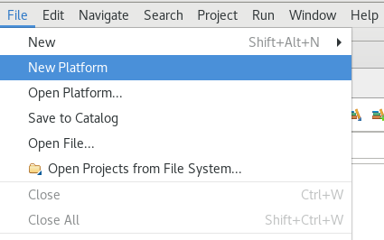
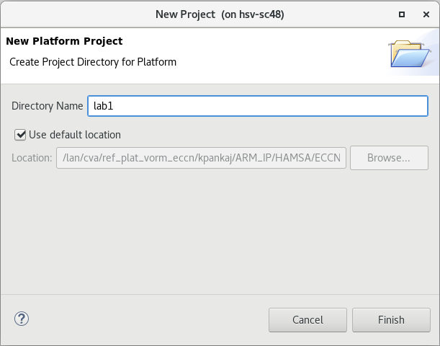
Step 2: Create a new platform Create a new platform
1. Create a new platform
2. Name it a55m35
a55m35

Slide 40
Steps
Step 1 – Create the ARM Fast Models
Step 2 – Create a new platform
Step 3 – Instantiate the a53_gic400 platform
Step 4 – Replace the A53 with A55
Step 5 – Replace the GIC400 with GIC600
Step 6 – Clean up
Step 7 – Instantiate the basic_m7 platform
Step 8 – Replace the M7 with M35
Step 9 – Set run options
Step 10 – Save the platform to a catalog
Step 11 – Build & run the platform

Slide 41
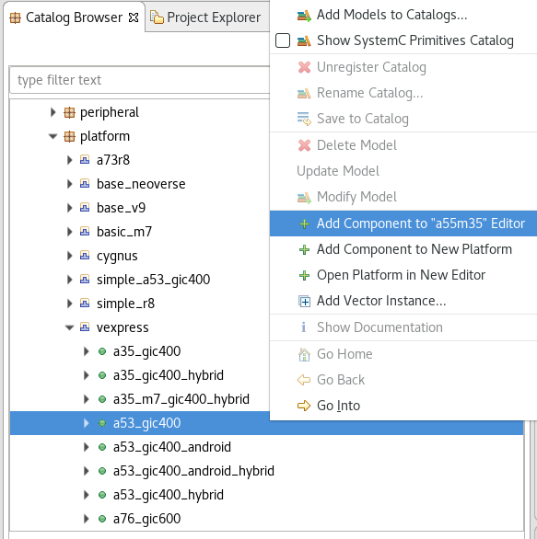
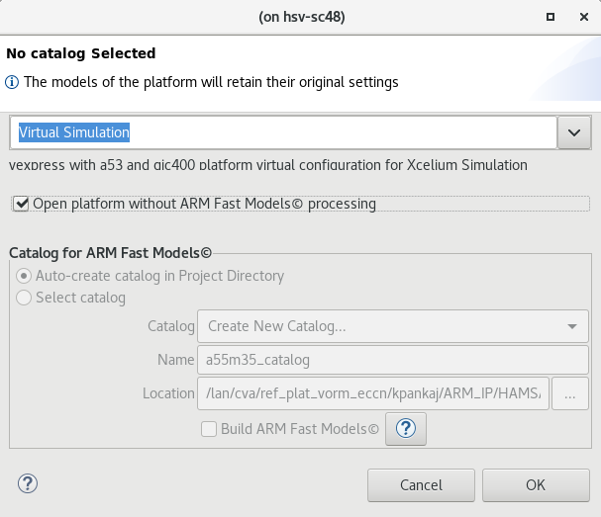
Step 3: Instantiate the a53_gic400 platform
1. Add the new platform
2. Disable FM processing
3. Ok

Slide 42
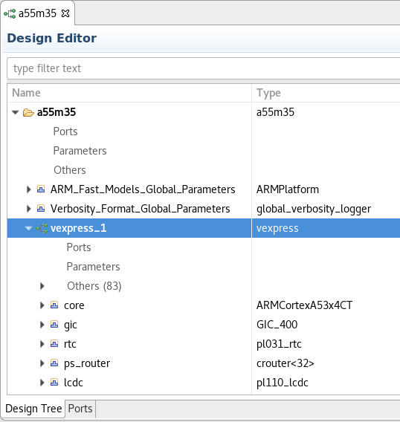
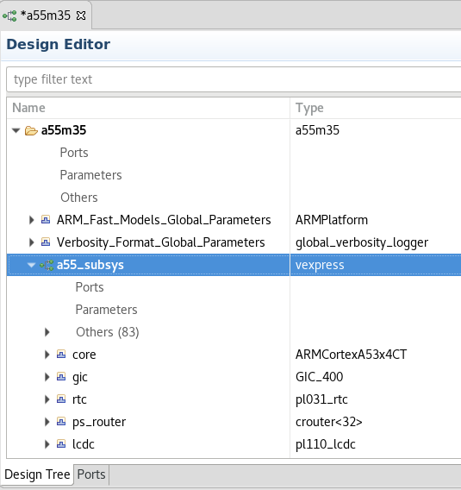
Step 3: Instantiate the a53_gic400 platform Rename the platform to a55_subsys

Slide 43
Steps
Step 1 – Create the ARM Fast Models
Step 2 – Create a new platform
Step 3 – Instantiate the a53_gic400 platform
Step 4 – Replace the A53 with A55
Step 5 – Replace the GIC400 with GIC600
Step 6 – Clean up
Step 7 – Instantiate the basic_m7 platform
Step 8 – Replace the M7 with M35
Step 9 – Set run options
Step 10 – Save the platform to a catalog
Step 11 – Build & run the platform

Slide 44
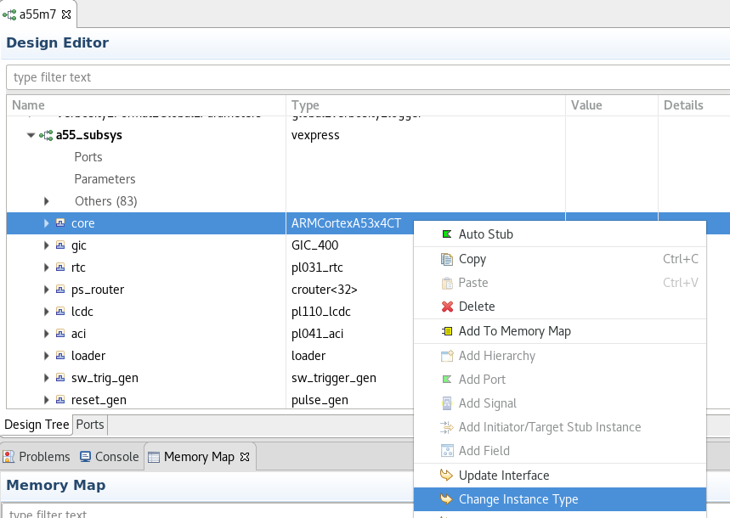
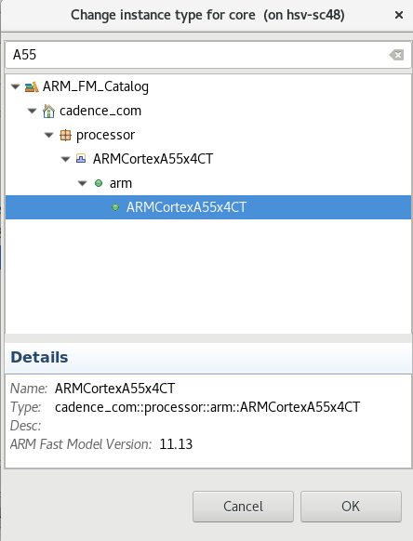
Step 4: Replace the A53 with A55 Replace core instance
2. Select ARMCortexA55x4CT
1. Change instance type
3. Ok

Slide 45
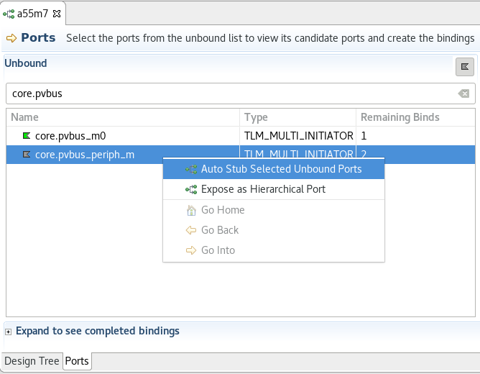
Step 4: Replace the A53 with A55 Auto stub core.pvbus_periph_m
2. Search for the port
1. Switch to the Ports tab
3. Auto stub

Slide 46
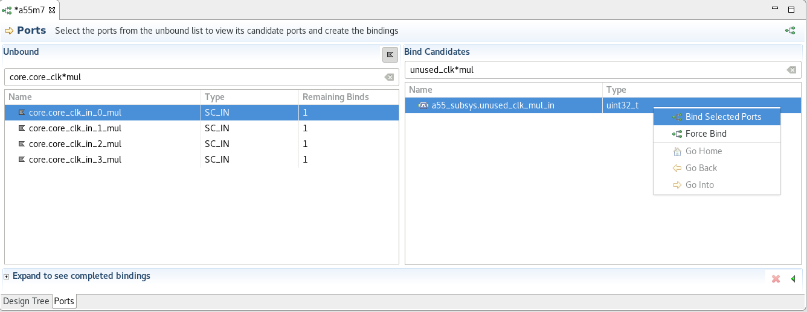
Step 4: Replace the A53 with A55 Connect core.core_clk*mul ports
Connect to unused_clk_mul_in

Slide 47

Step 4: Replace the A53 with A55 Connect core.core_clk*div ports
Connect to unused_clk_div_in

Slide 48
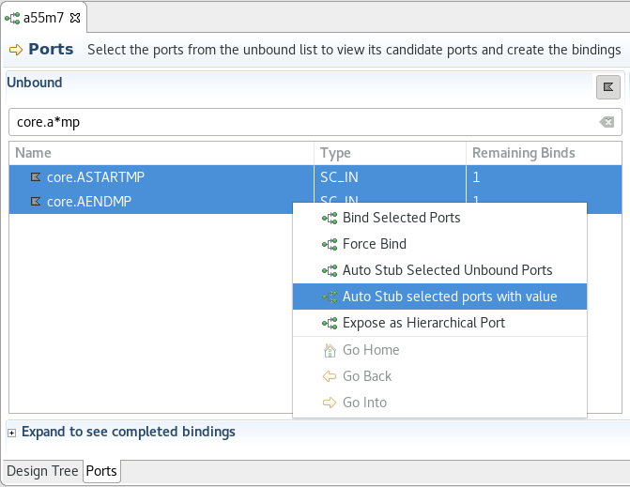
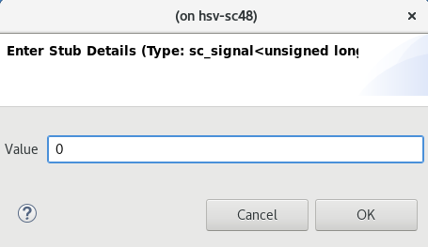
Step 4: Replace the A53 with A55 Connect core.ASTARTMP and core.AENDMP to 0
core.A*MP
2. Set value to 0
3. OK
1. Auto stub with value

Slide 49
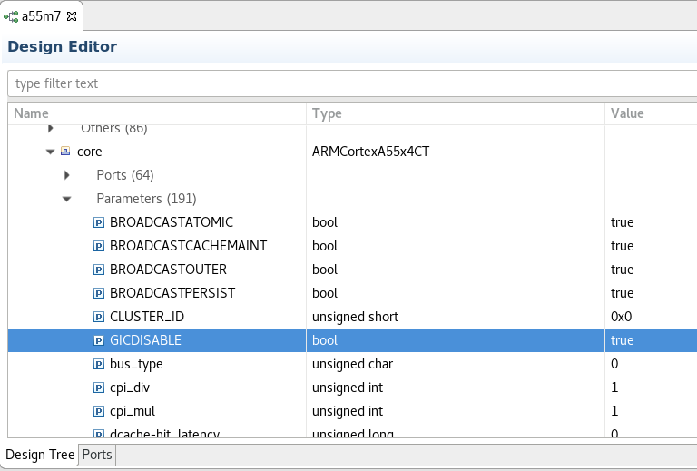
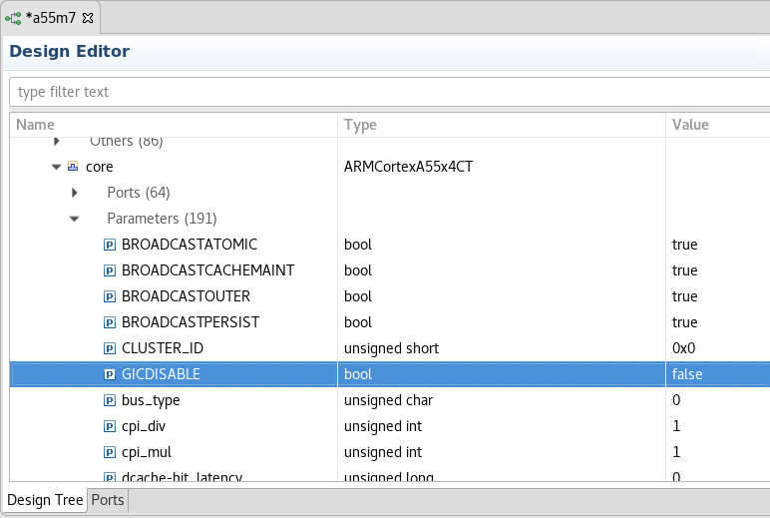
Step 4: Replace the A53 with A55 Enable GIC in the core
Change GICDISABLE parameter to false

Slide 50
Steps
Step 1 – Create the ARM Fast Models
Step 2 – Create a new platform
Step 3 – Instantiate the a53_gic400 platform
Step 4 – Replace the A53 with A55
Step 5 – Replace the GIC400 with GIC600
Step 6 – Clean up
Step 7 – Instantiate the basic_m7 platform
Step 8 – Replace the M7 with M35
Step 9 – Set run options
Step 10 – Save the platform to a catalog
Step 11 – Build & run the platform

Slide 51
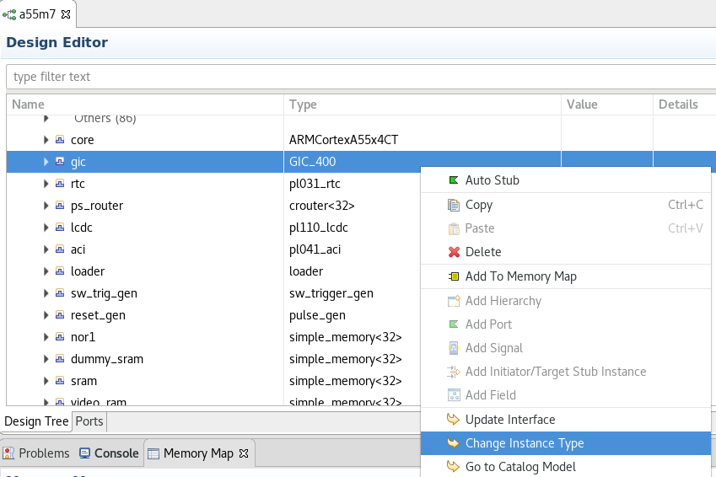
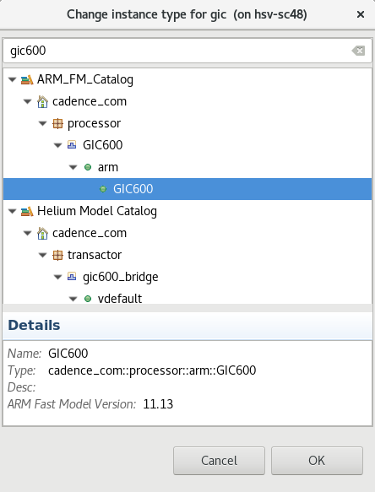
Step 5: Replace the GIC400 with GIC600 Replace gic instance
2. Select GIC600
1. Change instance type
3. Ok

Slide 52
Step 5: Replace the GIC400 with GIC600 Connect cpu_active_s and ppi_in ports using the Ports tab
Connect each signal of the gic.cpu_active_s[4] port to the main_reset signal
Connect the PPI ports:
Connect gic.ppi_in_0_10 to core.CNTHPIRQ_0
Connect gic.ppi_in_0_11 to core.CNTVIRQ_0
Connect gic.ppi_in_0_13 to core.CNTPSIRQ_0
Connect gic.ppi_in_0_14 to core.CNTPNSIRQ_0
Repeat for gic.ppi_in_1_*, gic.ppi_in_2_* and gic.ppi_in_3_*

Slide 53
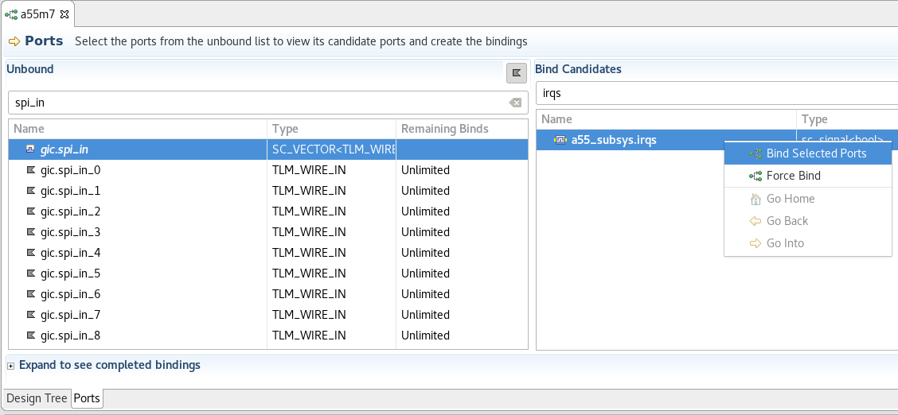
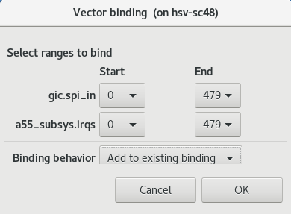
Step 5: Replace the GIC400 with GIC600 Connect SPI interrupt pins
4. Bind only 480 signals of the gic.spi_in port
5. Add to existing binding
1. Select the gic.spi_in[960] array
2. Select the irqs[480] array
3. Bind them (this may take a while)
6. Ok

Slide 54
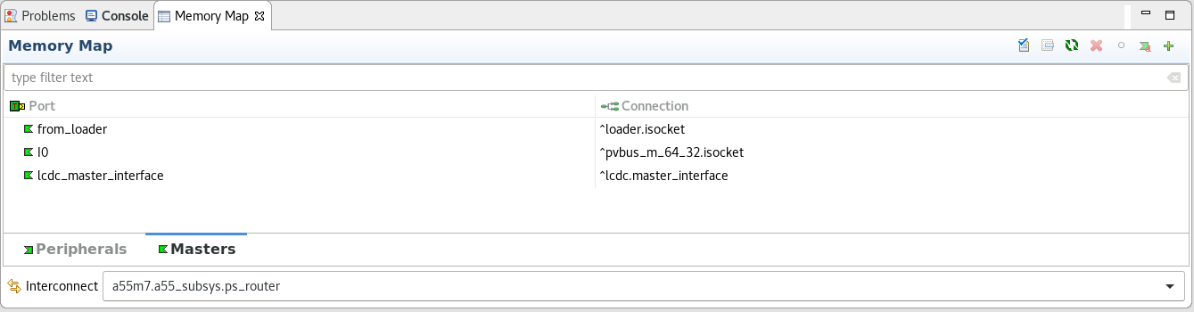
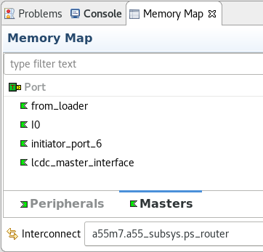

Step 5: Replace the GIC400 with GIC600 Add a new slave port to the interconnect
1. Add a new master in the Masters tab of the Memory Map
3. Reconfigure the interconnect
2. Rename the new master to from_gic

Slide 55


Step 5: Replace the GIC400 with GIC600 Connect the new interconnect port to the GIC
1. Connect ps_router.from_gic to gic.pvbus_m
2. Allow Helium to add a bus width converter

Slide 56

Step 5: Replace the GIC400 with GIC600 Connect the GIC to the CPU
Unbind core. gicv3_redistributor_s_pvbus_s
and core. gicv3_redistributor_s_pvbus_m

Slide 57
Step 5: Replace the GIC400 with GIC600 Connect the GIC to the CPU
Connect core. gicv3_redistributor_s_pvbus_s to gic.redistributor_m_pvbus_m
Connect core. gicv3_redistributor_s_pvbus_m to gic.redistributor_m_pvbus_s

Slide 58
Steps
Step 1 – Create the ARM Fast Models
Step 2 – Create a new platform
Step 3 – Instantiate the a53_gic400 platform
Step 4 – Replace the A53 with A55
Step 5 – Replace the GIC400 with GIC600
Step 6 – Clean up
Step 7 – Instantiate the basic_m7 platform
Step 8 – Replace the M7 with M35
Step 9 – Set run options
Step 10 – Save the platform to a catalog
Step 11 – Build & run the platform

Slide 59


Step 6: Clean up Remove unnecessary sockets
Delete unnecessary sockets

Slide 60
Steps
Step 1 – Create the ARM Fast Models
Step 2 – Create a new platform
Step 3 – Instantiate the a53_gic400 platform
Step 4 – Replace the A53 with A55
Step 5 – Replace the GIC400 with GIC600
Step 6 – Clean up
Step 7 – Instantiate the basic_m7 platform
Step 8 – Replace the M7 with M35
Step 9 – Set run options
Step 10 – Save the platform to a catalog
Step 11 – Build & run the platform

Slide 61

Step 7: Instantiate the basic_m7 platform
3. Disable FM processing
1. Select the topmost a55m35 node in the Design Editor
2. Add basic_m7 platform
4. Ok

Slide 62


Step 7: Instantiate the basic_m7 platform Rename the platform to m35_subsys

Slide 63
Steps
Step 1 – Create the ARM Fast Models
Step 2 – Create a new platform
Step 3 – Instantiate the a53_gic400 platform
Step 4 – Replace the A53 with A55
Step 5 – Replace the GIC400 with GIC600
Step 6 – Clean up
Step 7 – Instantiate the basic_m7 platform
Step 8 – Replace the M7 with M35
Step 9 – Set run options
Step 10 – Save the platform to a catalog
Step 11 – Build & run the platform

Slide 64


Step 8: Replace the M7 with M35 Replace core instance
2. Select ARMCortexM35PCT
1. Change instance type
3. Ok

Slide 65


Step 8: Replace the M7 with M35 Instantiate IDAU
1. Select m35_subsys
2. Add IDAU
3. Rename the instance to IDAU

Slide 66


Step 8: Replace the M7 with M35 Connect IDAU to the M35
Connect core.idau to IDAU.pvbus_s
Connect core.idau_invalidate_region to IDAU.invalidate_region

Slide 67
Step 8: Replace the M7 with M35 Stub unused ports
Stub these ports of the M35 core:
core.intnum: auto-stub
core.stcalib[2]: auto-stub with value 0
core.initsvtor, core.initnsvtor: auto-stub with value 0

Slide 68


Step 8: Replace the M7 with M35 Delete unnecessary sockets and models
Delete unused_dap_s and unused_ahbd
Delete ahbp_m_64_32 and ahbs_32_64

Slide 69



Step 8: Replace the M7 with M35 Delete unnecessary peripherals and masters in the memory map
1. Select the ps_router in the m35_subsys
2. Delete ahbp_m (in Masters) and m7_ahb_s_tcm (in Peripherals)
3. Reconfigure the router connections

Slide 70



Step 8: Replace the M7 with M35 Add an SRAM instance
1. Select the m35_subsys
2. Add a simple_memory_32 instance
3. Rename it to sram

Slide 71


Step 8: Replace the M7 with M35 Add the SRAM to the memory map
1. Add the SRAM to the memory map
2. Reconfigure the router

Slide 72

Step 8: Replace the M7 with M35 Connect the SRAM reset pin
Connect sram.reset_in to main_reset

Slide 73

Step 8: Replace the M7 with M35 Set up the memory map
2. Reconfigure the router connections
1. Adjust ranges:
SRAM: Start = 0x00000000, Size = 0x00010000
DDR: Start = 0x20000000, Size = 0x00020000
DMA: Start = 0x4c010000, Size = 0x00001000
UART0: Start = 0x4c000000, Size = 0x00001000

Slide 74
Steps
Step 1 – Create the ARM Fast Models
Step 2 – Create a new platform
Step 3 – Instantiate the a53_gic400 platform
Step 4 – Replace the A53 with A55
Step 5 – Replace the GIC400 with GIC600
Step 6 – Clean up
Step 7 – Instantiate the basic_m7 platform
Step 8 – Replace the M7 with M35
Step 9 – Set run options
Step 10 – Save the platform to a catalog
Step 11 – Build & run the platform

Slide 75


Step 9: Set run options Set run options
-cciparam a55m35.a55_subsys.loader.source0=`heliumlib`/releasecatalog/cadence.com/software/vexpress_simple_soc/images/linux-armv82-gic600.axf
-cciparam a55m35.a55_subsys.loader.source1=`heliumlib`/releasecatalog/cadence.com/software/vexpress_simple_soc/images/boot-armv8.bin
-cciparam a55m35.a55_subsys.loader.destination1=0x0
-cciparam a55m35.m35_subsys.loader.source0=${TRAINING_MAT_DIR}/images/cpuinfo.elf
TRAINING_MAT_DIR is set by the setup.csh script accompanying the training materials for this lab

Slide 76
Steps
Step 1 – Create the ARM Fast Models
Step 2 – Create a new platform
Step 3 – Instantiate the a53_gic400 platform
Step 4 – Replace the A53 with A55
Step 5 – Replace the GIC400 with GIC600
Step 6 – Clean up
Step 7 – Instantiate the basic_m7 platform
Step 8 – Replace the M7 with M35
Step 9 – Set run options
Step 10 – Save the platform to a catalog
Step 11 – Build & run the platform

Slide 77


Step 9: Save the platform to a catalog Save to catalog
Create a new catalog
Give it a name and browse to any directory for its location. Remember this directory, it will be used later.
Name the platform a55m35
Name the platform variant vdefault

Slide 78
Steps
Step 1 – Create the ARM Fast Models
Step 2 – Create a new platform
Step 3 – Instantiate the a53_gic400 platform
Step 4 – Replace the A53 with A55
Step 5 – Replace the GIC400 with GIC600
Step 6 – Clean up
Step 7 – Instantiate the basic_m7 platform
Step 8 – Replace the M7 with M35
Step 9 – Set run options
Step 10 – Save the platform to a catalog
Step 11 – Build & run the platform

Slide 79


Step 10: Build & run the platform (GUI) Build and run the platform from the GUI
1. Build the platform
2. Run the platform

Slide 80


Step 10: Run output
M35 subsystem UART output
A55 subsystem UART output

Slide 81
Step 10a: Build & run the platform (command line) Build and run from the command line
To build and elaborate the platform:
make -f <catalog directory>/<catalog name>/cadence.com/platform/a55m35/vdefault/makefile elab
To run the platform:
make -f <catalog directory>/<catalog name>/cadence.com/platform/a55m35/vdefault/makefile run
Note:
<catalog directory> is the directory where you created a catalog in Step 9 previously.
<catalog name> is the name you gave the catalog (with spaces replaced with underscores) in Step 9 previously.

